Slide 1
Hillsboro Airport
Fall Community Forum
Aeropuerto de Hillsboro
Foro Comunitario de Otoño
November 4, 2025, 5-7p.m.
4 de noviembre de 2025, de 5 a 7 p.m.
Notes:
FRANCES
SAY: Hello everyone, Welcome to the Hillsboro Airport Fall Community Forum. Today is Tuesday, November 4th and we will be here at Hidden Creek from around 5p.m. to 7p.m. The online portion of this meeting will end at 6:30p.m.
SAY: My name is Frances Portillo with Portillo Consulting and am today’s facilitator.
SAY: [Say a little more about you]
SAY: Next slide please.

Slide 2
Meeting format overview / Descripción General del Formato de la Reunión
Zoom Overview | Descripción General de Zoom
Recording: Meeting is being recorded. Mute: Please mute yourself when not speaking. Closed Captioning via Zoom control panel. Spanish Interpretation Available: Click the globe icon and select “Spanish.” Q&A Box (bottom of Zoom screen): Submit a question or comment at any time “Like” or upvote questions from others Questions will be addressed in Q&A. Add your name into the box and you will have 3 minutes for public comment or to ask your question verbally Tech issues? Message staff in the box. | Grabación: La reunión está siendo grabada. Silenciar el micrófono: Por favor, apague el micrófono cuando no esté hablando. Subtítulos disponibles: Puede activar los subtítulos desde el panel de control de Zoom. Interpretación al español disponible: Haga clic en el icono del globo terráqueo y seleccione “Español”. Cuadro de preguntas y respuestas (parte inferior de la pantalla de Zoom "Q&A"): Envíe una pregunta o comentario en cualquier momento. Haga clic en "Me gusta" o vote a favor de las preguntas de otros. Las preguntas se responderán durante la sesión de preguntas y respuestas. Añada su nombre en el cuadro y tendrá 2 minutos para hacer un comentario público o formular su pregunta verbalmente. ¿Problemas técnicos? Envíe un mensaje al personal en el cuadro.
Notes:
FRANCES
SAY: First, let’s take care of some logistics.
The meeting will be recorded for notetaking purposes
Please remember to mute yourself when not speaking.​
For today’s meeting, we have closed captioning and Spanish interpretation available. To access Spanish interpretation, please click on the globe icon at the bottom right of your screen and select “Spanish”. To access closed captioning, click on the ‘CC’ button on the bottom right side of your screen.
Q&A Box: Today, we have the Q&A feature available. We will use this multiple for purposes:
Submit a question or comment at any time
“Like” or upvote questions from others
If you’re interested in providing verbal public comment, add your name into the box and during the Q&A session, you will have 2 minutes for public comment.
If you’d like to ask your question verbally, you can also just add your name into the Q&A box
If you need tech support, please send a message via the Q&A box
SAY: Next slide

Slide 3
Group Agreements / Acuerdos Grupales
Group Agreements | Acuerdos Grupales
Share the space Listen to understand Take care of yourself | Comparta el espacio Escuche para entender Tome cuidado de sí mismo
Notes:
FRANCES
SAY: Before we get started, I want to quickly go over the group agreements for today's session.
​
SAY: As we share space, let’s be mindful of our group agreements so we can create a welcoming and safe environment for everyone​
This forum is an opportunity for you to be heard and for all of us to listen to each other. Please be mindful of how much you speak and create space for others to share, we value everyone’s perspective​
Listen for the learning opportunities​
Be attentive to your needs, do what’s necessary to feel comfortable​
SAY: By staying in this session, we assume you agree to abide by these group agreements.
SAY: Next slide

Slide 4
Agenda
Time / Tiempo | Activity | Actividad
10 mins | Welcome and Introductions | Bienvenida y presentaciones
15 mins | Community sponsors spotlight | Enfoque en los asociados comunitarios
30 mins | Hillsboro Airport Updates Background Business report (noise, tenants, construction, etc.) Unleaded avgas readiness and transition plan Block Party update | Actualizaciones del aeropuerto de Hillsboro Antecedentes Informe comercial (ruido, inquilinos, construcción, etc.) Preparación para el combustible de aviación sin plomo y plan de transición Actualización sobre el evento comunitario
30 mins | Q&A / Public Comment | Preguntas y respuestas / Comentarios públicos
5 mins | Zoom meeting closed; in-person break | Cierre de la reunión de Zoom; descanso presencial
25 min | In-person table topic conversations | Conversaciones presenciales por mesas temáticas
Notes:
FRANCES
SAY: Today’s agenda includes:
Community sponsors spotlight
A presentation on Hillsboro Airport updates
Time for Q&A and public comment
The online meeting will end at 6:30p.m. but will continue for about 30 minutes for in-person guests to talk with Port staff or community members.
SAY: A quick note about our Q&A / Public Comment section - it’s important for us to hear from you, our community members. The opportunity to hear public comment and questions around 6p.m. until 6:30p.m.
SAY: With that, I’ll pass it to Nikoyia Phillips from the Port of Portland to introduce our community sponsors.

Slide 5


Community Sponsor Spotlights /
Enfoque en los Asociados Comunitarios
Notes:
Nikoyia
SAY: Nikoyia Phillips, Director of Community Impact [introduction]
SAY: Community sponsors help increase the Port’s reach in the Hillsboro community by stretching our outreach efforts.
SAY: Greater Than and Oregon Air Show Charitable Foundation are two community organizations working in the Hillsboro area with a track record of engaging kids and families.
SAY: We also have missions that compliment each other as we both want to increase access to quality jobs for everyone by bringing down barriers and working with people intentionally.
SAY: We’ll give both organization’s leaders a few minutes to share more about their work.
SAY: First up, I’d like to introduce Jessica Arzate (ARE-SAW-TAY) and Elizabeth Rodriguez from Greater Than.

Slide 6

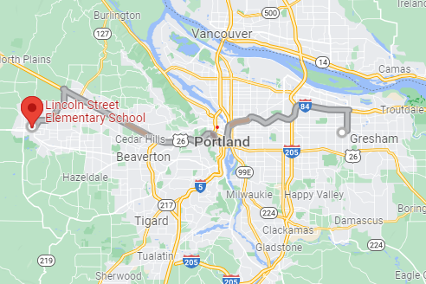
Greater Than / Mayor Que
We serve schools in two distinct communities,
Rockwood and Downtown Hillsboro (Lincoln Street).
While the communities are more than 30 miles apart, they share many strengths and are both high opportunity communities. Both of these neighborhoods have been impacted by systemic racism, holding back families from thriving to their fullest potential.
Brindamos servicios a escuelas de dos comunidades distintas:
Rockwood y el centro de Hillsboro (Lincoln Street).
Aunque las comunidades están separadas por más de 30 millas, comparten muchas fortalezas y ambas ofrecen grandes oportunidades. Ambos vecindarios se han visto afectados por el racismo sistémico, lo que ha impedido que las familias alcancen su máximo potencial.

Slide 7


GT Review / Repaso de Mayor Que (GT)
Misión​
Apoyar y empoderar a los estudiantes de comunidades afectadas por la pobreza para que prosperen en la escuela, la universidad y su carrera profesional.​
Alcance​
Nuestros apoyos programáticos incluyen el aprendizaje temprano, intervenciones desde preescolar hasta secundaria, éxito en la educación superior y una incorporación satisfactoria al mundo laboral. Trabajamos continuamente para ampliar nuestras alianzas y relaciones con el fin de brindar servicios de apoyo sólidos en todos los puntos del continuo educativo.​
Mission
Supporting and empowering students from poverty-impacted communities to thrive in school, college and career.
Scope
Our programmatic supports include early learning, K-12 interventions, post-secondary success, and successful entry into career. We continuously work to expand our partnerships and relationships to provide robust support services across all points of the education continuum.
Notes:
Jessica:
At the heart, our organization is an education nonprofit deeply rooted with community and committed to transform public education for underrepresented and historically excluded students by providing them with individualized holistic supports from pre-K through high school and beyond to ensure they can overcome systemic barriers to thrive in school, college, and career.

Slide 8
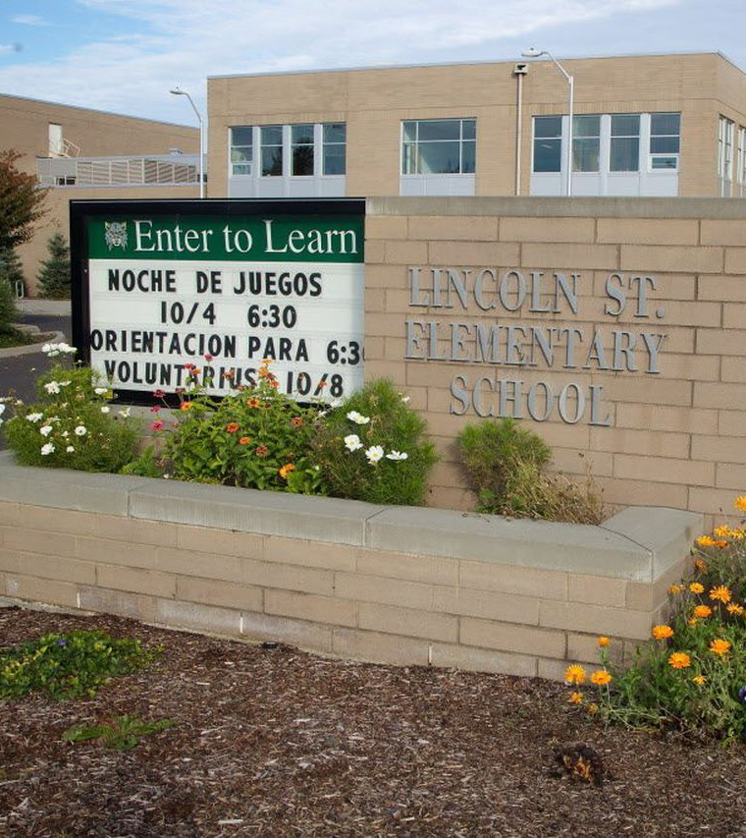
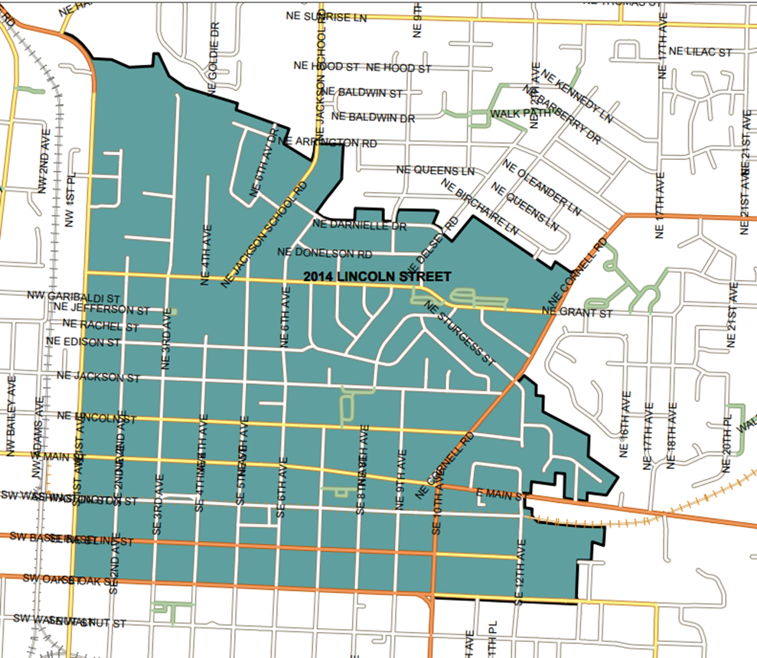
Lincoln Street Elementary School
Hillsboro School District
Distrito Escolar de Hillsboro
Notes:
Elizabeth:
In 2020, Greater Than expanded to a second site at Lincoln Street Elementary School in Hillsboro. Our partnership includes a 15 year contract with the Hillsboro School District to implement our Impact Model.

Slide 9
Our Approach / Nuestro Enfoque
Whole School Model at Lincoln Street Elementary
Modelo escolar integral en las escuelas primarias Lincoln Street y Alder
We provide support to students, families, teachers, and stakeholders at the elementary school level. This includes coordinating partners to serve in alignment with their expertise, convening parent stakeholders to listen to and learn from them, facilitating a culture of college and career, and some direct service programming when needs can’t be met directly by partners.
Brindamos apoyo a los estudiantes, las familias, los maestros y las partes interesadas en el nivel de primaria. Esto incluye coordinar a los asociados para que brinden sus servicios de acuerdo con su experiencia, convocar a los padres interesados para escucharlos y aprender de ustedes, facilitar una cultura universitaria y profesional, y algunos programas de servicios directos cuando las necesidades no pueden ser cubiertas directamente por los asociados.
Notes:
Individualized Advocacy Model
When students transition to middle and high school, we support them with an individualized advocacy model. Historically, our approach allowed students to “opt-in” to our programs but over at the RSD middle & high schools, we are moving towards a tiered system of intervention. This system focuses more on individual student support than on school systems and partnerships. Our programming builds on the many strengths of Greater Than students.

Slide 10
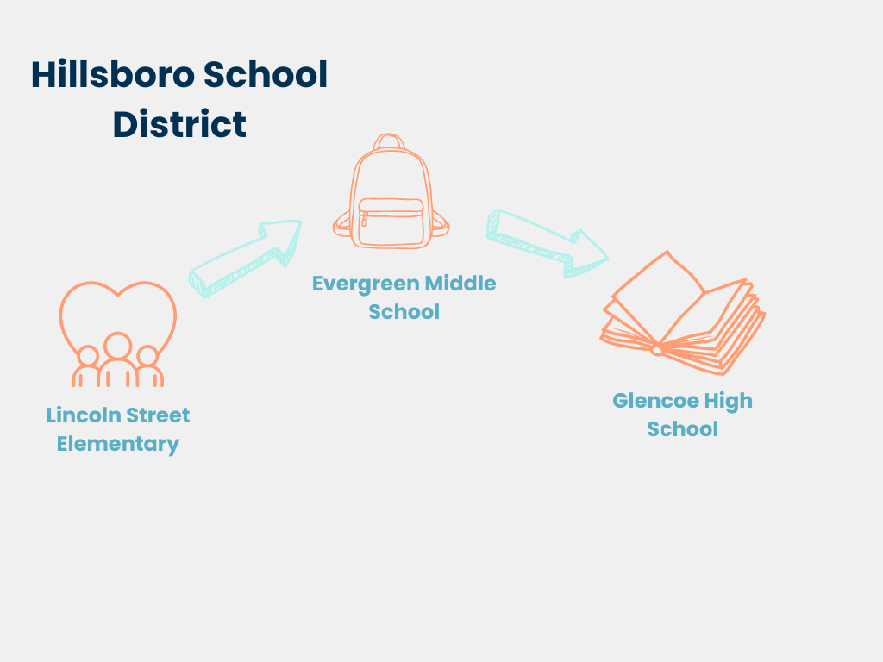

Slide 11
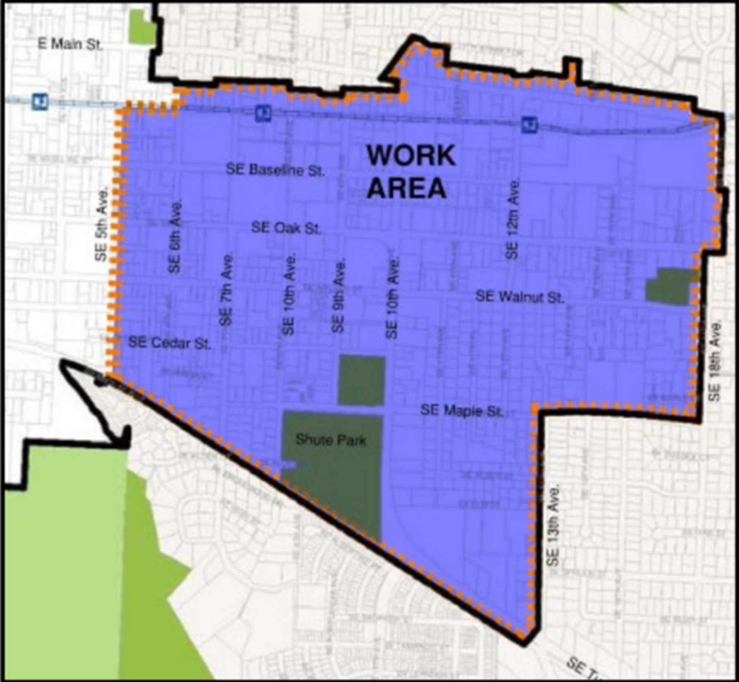
Avenida Diez
The City of Hillsboro is seeking to build a framework for permanent community engagement and support for the Avenida Diez neighborhood, in line with community members’ goals.
Project Management Team:
•EcoNorthwest
•Bienestar
•Greater Than
La ciudad de Hillsboro aspira a crear un modelo de participación y apoyo comunitario permanente para el vecindario de Avenida Diez, de acuerdo con los objetivos de los miembros de la comunidad.​
​
Equipo de administración del proyecto:​
•EcoNorthwest​
•Bienestar​
•Greater Than ​
Notes:
Elizabeth:
In 2024, Greater Than was selected to be part of the Avenida Diez Equitable Development project Team with the City of Hillsboro. The project focuses on creating strategies to benefit the existing community and prevent displacement.
We have led community engagement efforts for the Community Advisory Committee and recruited families from Lincoln Street ES to be part of this group. Part of our role is helping to facilitate monthly meetings of the CAC and convening focus groups to give input on the project’s goals and progress.
Jessica:
We are grateful for this partnership with the Port of Portland and the Hillsboro Airport. This forum is an important step for us as we are actively expanding and growing our Community Advocacy and Equitable Redevelopment work in Hillsboro. Our goal is to equip and support families to lead advocacy efforts that address systemic barriers impacting their children’s education and well-being. As an education-focused organization, we understand that what happens outside the classroom, such as unsafe streets, displacement, and environmental harm, profoundly affects a child’s ability to learn and thrive in school.
Thank you.

Slide 12







OREGON AIRSHOW CHARITABLE FOUNDATION /
FUNDACIÓN BENÉFICA DE LA EXHIBICIÓN AÉREA DE OREGÓN
The Oregon Airshow Charitable Foundation provides scholarships and hands-on learning opportunities to students from diverse backgrounds, empowering them to pursue careers in aviation and aerospace.
OUR MISSION
To support and inspire those with a passion for flight and a desire to learn.
OUR VISION
To promote and fund aviation career education through scholarships and other support to worthy students and organizations located in the Pacific Northwest.
OUR PARTNERS / NUESTROS ASOCIADOS
La Fundación Benéfica de la Exhibición Aérea de Oregón brinda becas y oportunidades de aprendizaje práctico a estudiantes de diversos orígenes, empoderándolos para seguir carreras en la aviación y la industria aeroespacial.
NUESTRA MISIÓN
Apoyar e inspirar a aquellos que sienten pasión por volar y desean aprender.
NUESTRA VISIÓN
Promover y financiar la educación profesional en aviación mediante becas y otras ayudas a estudiantes y organizaciones merecedoras ubicadas en la región del noroeste del Pacífico.

Slide 13

OUR IMPACT /
OASCF
NUESTRO IMPACTO
PNW-ACE
O-ACE EDUCATION
NEXTGEN AFTERSCHOOL CLUBS
WORKFORCE SYMPOSIUM
Oregon Aerospace Careers For Everyone Education
(O-ACE)
Education classes that produce confident, adventurous leaders, inspires youth to choose aviation career pathways, and provides career pathways through Career Technical Education.
NextGen Aviation Club (AC) – Afterschool Flying Clubs
Designed to inspire, educate, and prepare the next generation of aviation professionals through professional mentorship, hands-on learning, and career development opportunities.
Workforce Development Symposium
A student-lead, student-run leadership opportunity designed to connect our next generational leaders to industry professionals.
Carreras Aeroespaciales en Oregón para todos (O-ACE)
Cursos educativos que forman líderes seguros y aventureros, inspiran a los jóvenes a elegir carreras relacionadas con la aviación y brindan vías profesionales a través de la educación técnica profesional.
Club de Aviación NextGen (AC): clubes de vuelo extraescolares
Diseñado para inspirar, educar y preparar a la próxima generación de profesionales de la aviación a través de la tutoría profesional, el aprendizaje práctico y las oportunidades de desarrollo profesional.
Simposio sobre desarrollo de la fuerza laboral
Una oportunidad de liderazgo dirigida y gestionada por estudiantes, diseñada para conectar a nuestros líderes de la próxima generación con profesionales de la industria.

Slide 14
Hillsboro Airport Update / Actualización sobre el Aeropuerto de Hillsboro
Background
Business Report
Unleaded Avgas Transition and Readiness Plan Briefing
Block Party Recap
Antecedentes
Informe comercial (ruido, inquilinos, construcción, etc.)
Preparación para el combustible de aviación sin plomo y resumen del plan de transición
Actualización sobre el evento comunitario
Notes:
Frances
SAY: Thank you to our community sponsors.
SAY: Now it’s time for an update on Hillsboro Airport.
SAY: To give us some context for the work at Hillsboro Airport, we’ll begin with Nikoyia sharing more about the mission and role of the Port of Portland — whose work goes beyond just managing the Hillsboro airport.

Slide 15
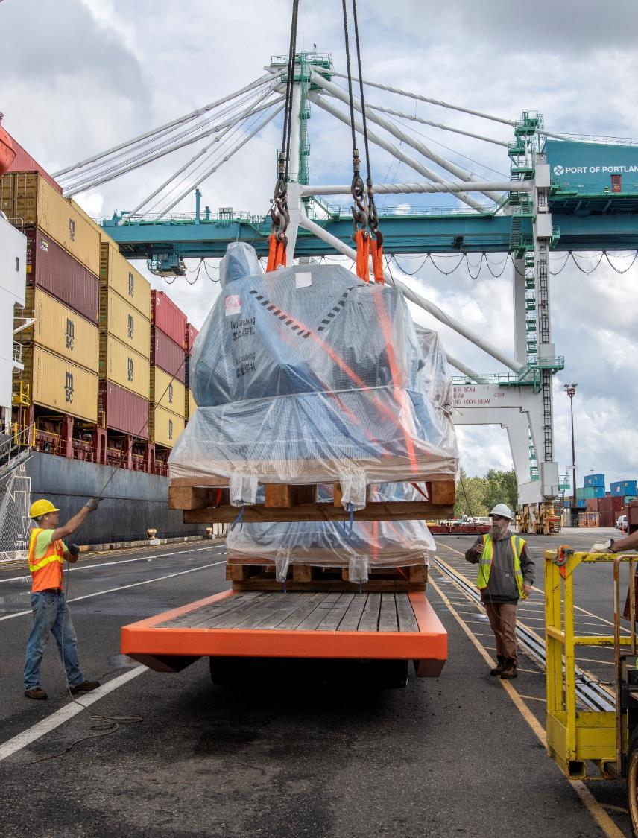
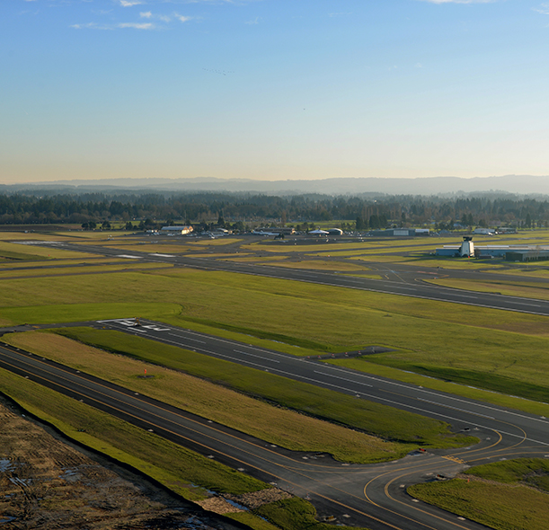
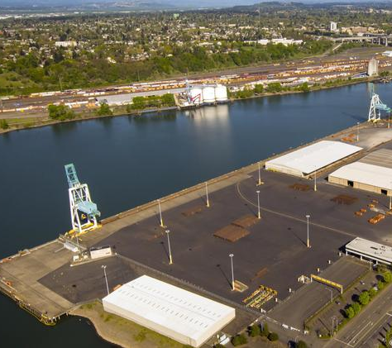
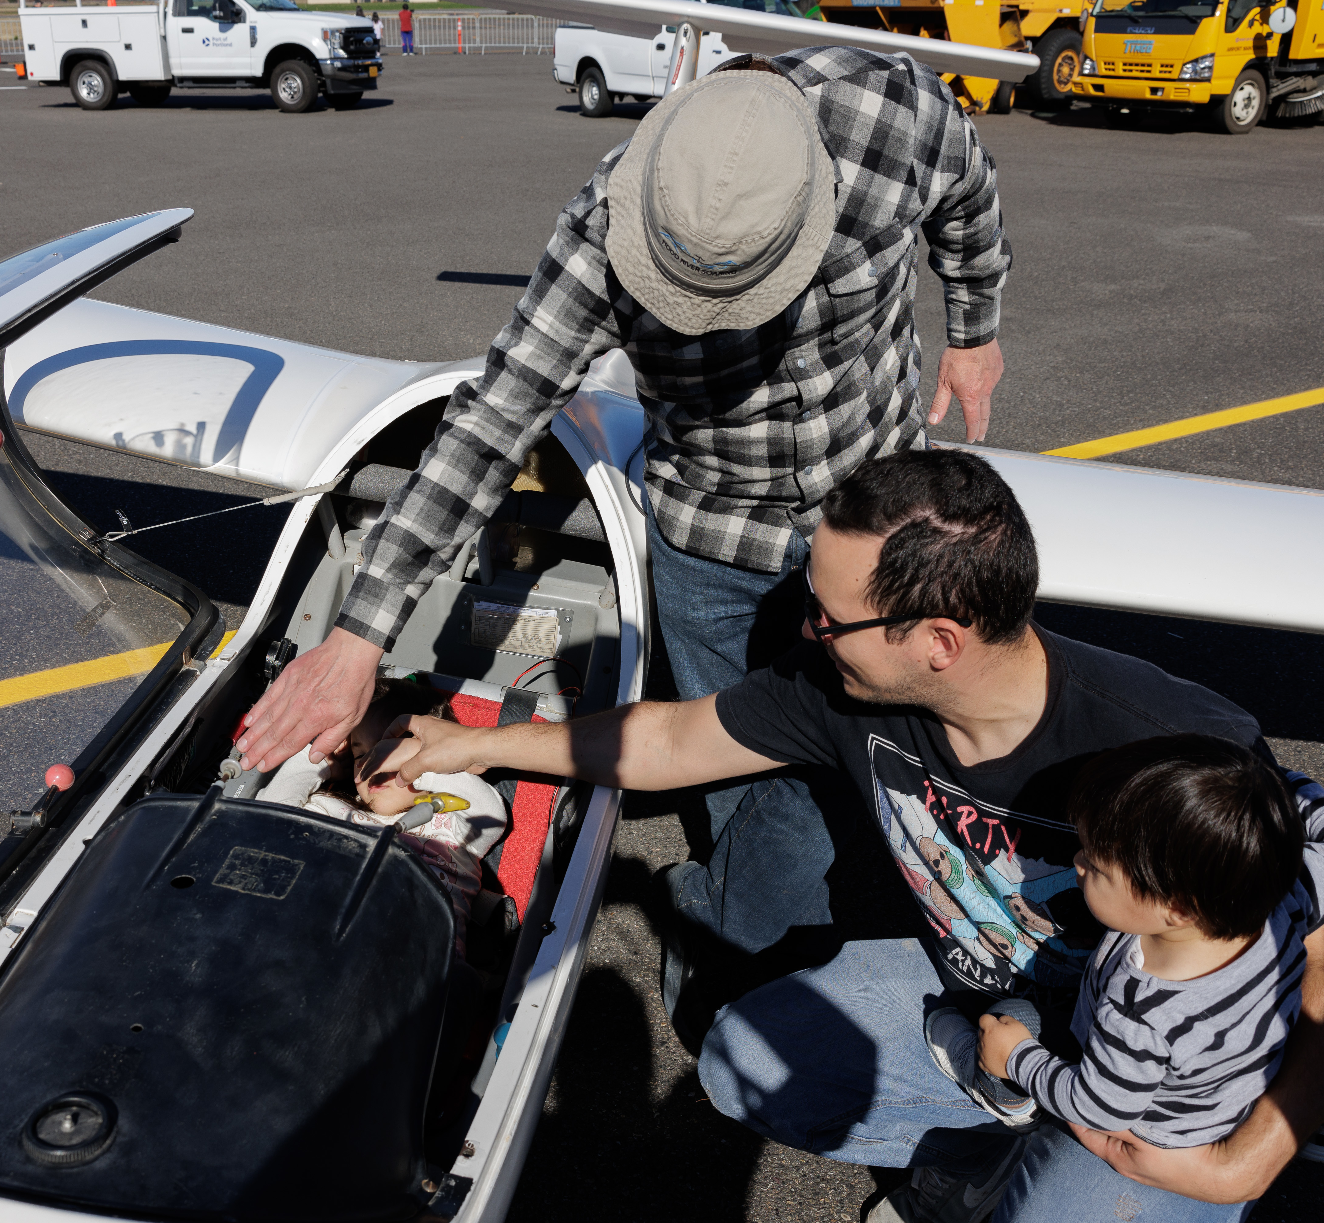
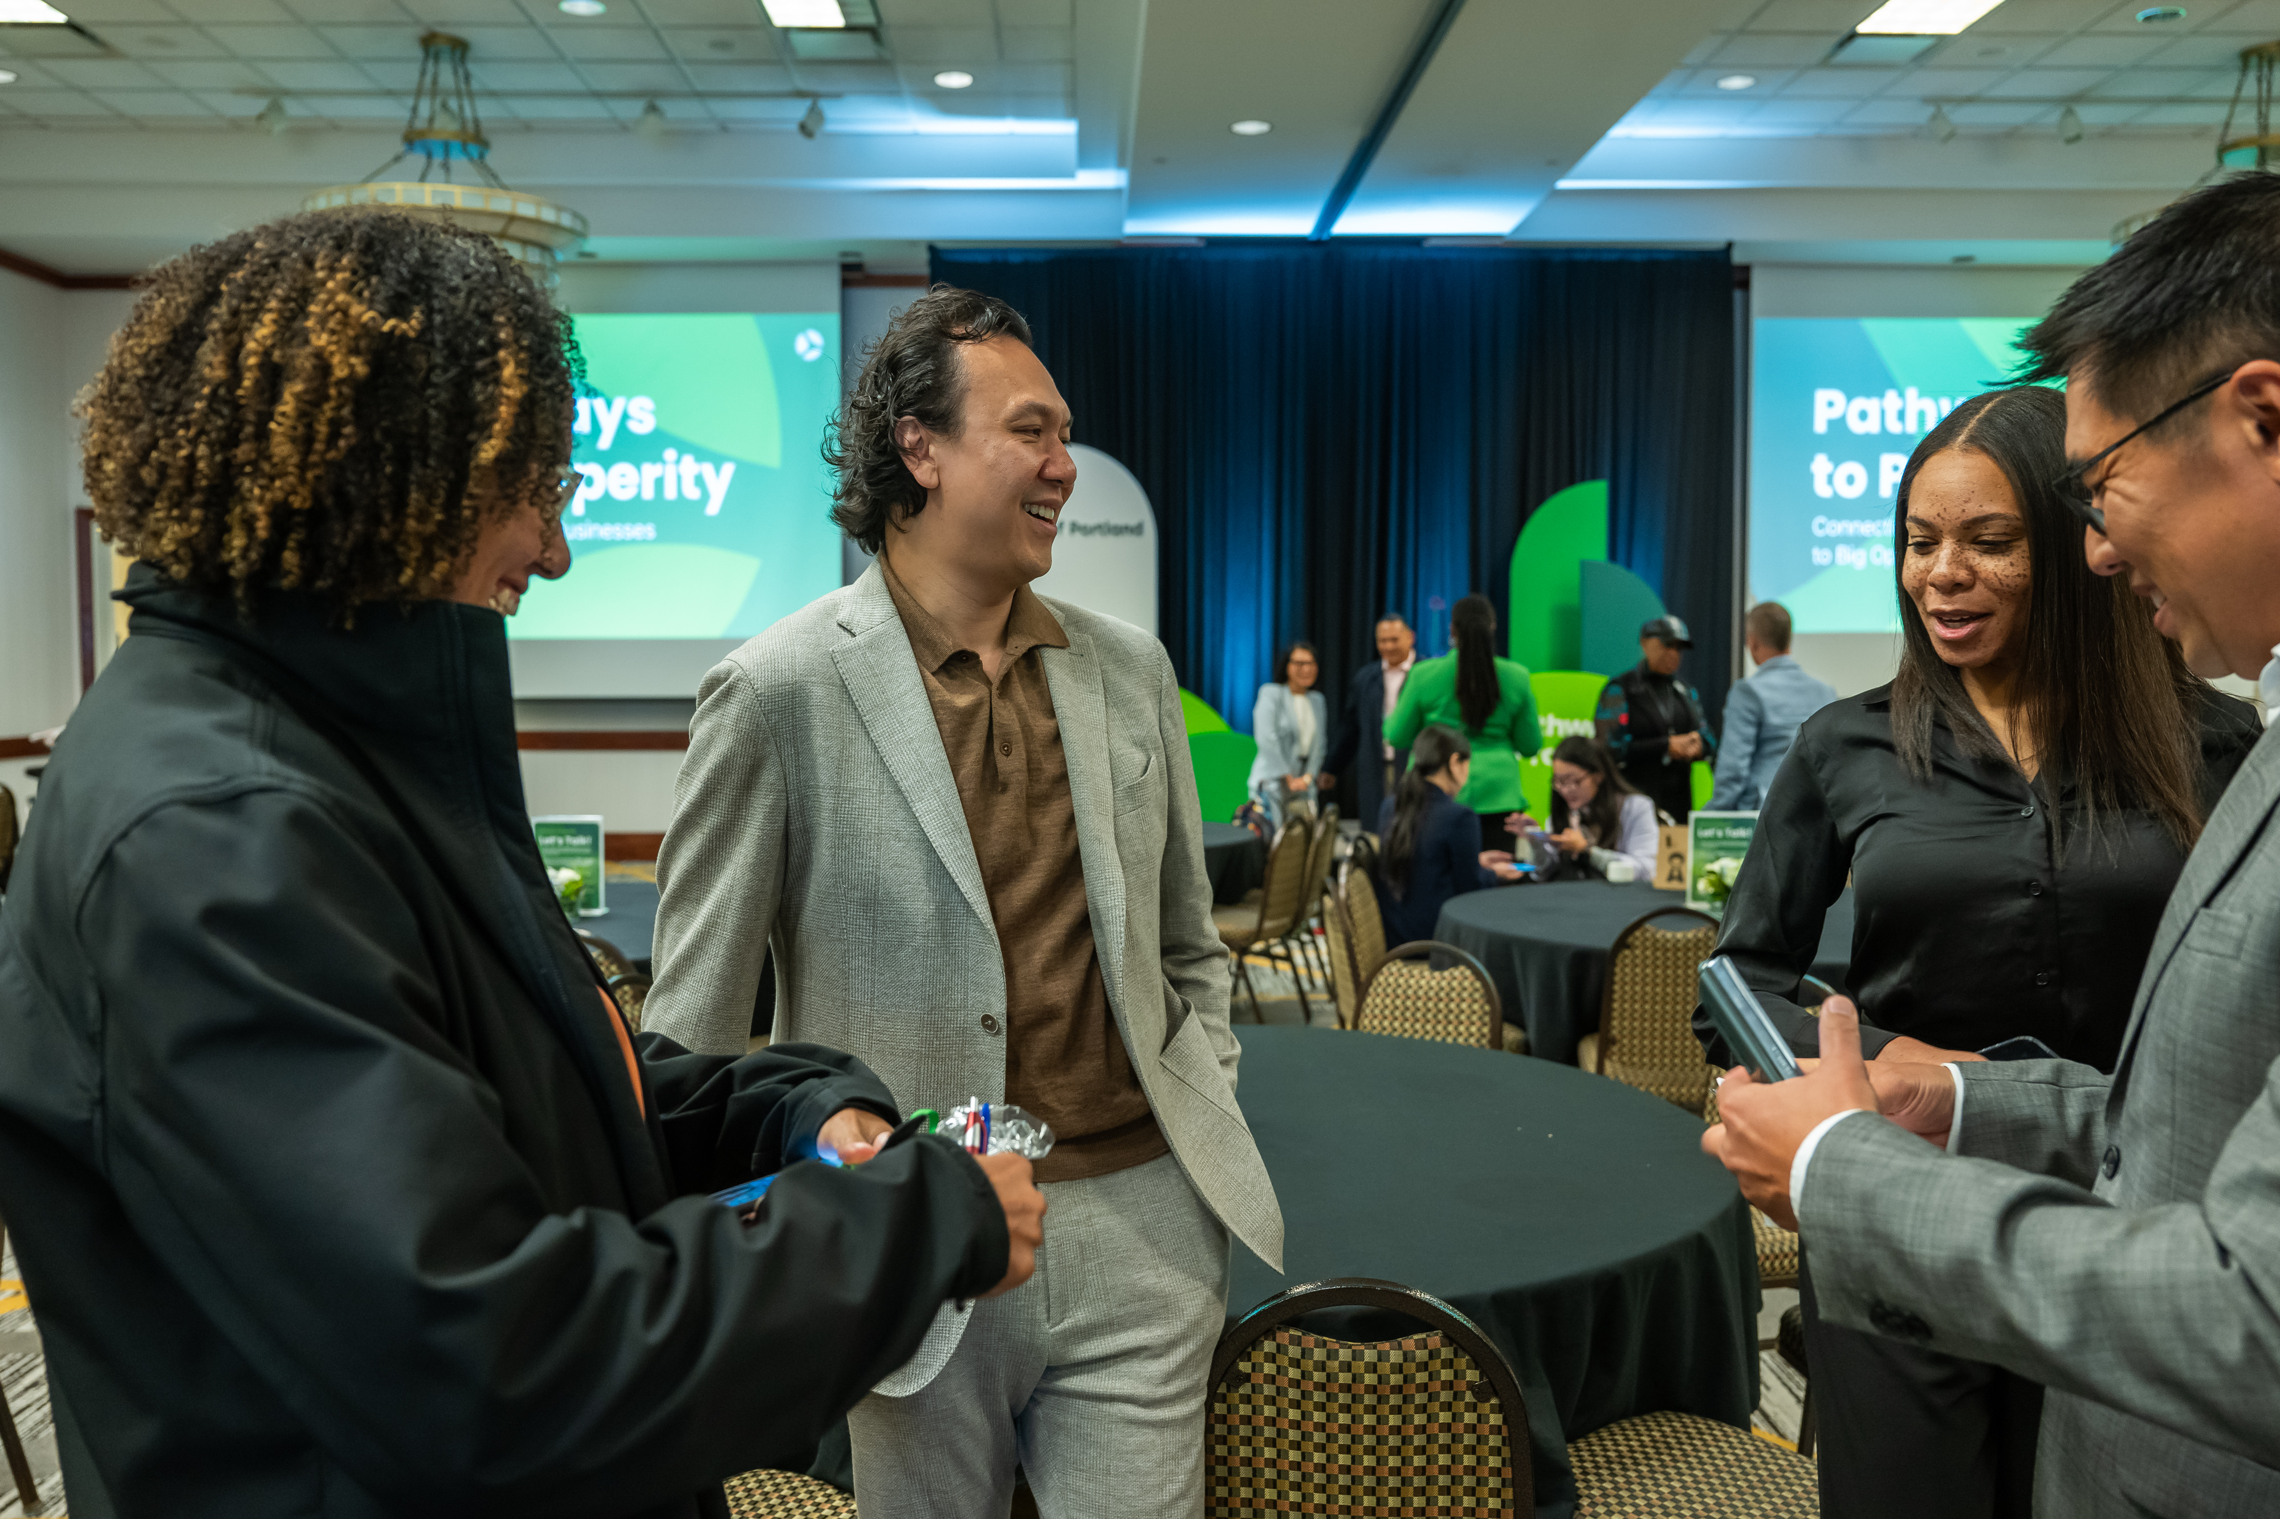
Port of Portland
We’re an economic engine for our region, creating opportunity for everyone who lives and
works here.
Somos un motor económico para nuestra región, creando oportunidades para todos los que viven y trabajan aquí.
Notes:
Nikoyia
SAY: The Port of Portland has been around for more than 125 years. It was chartered in 1891 by the Oregon Legislature to build and maintain a navigation channel on the Willamette and Columbia Rivers between Portland and the sea.
SAY: Today, the Port’s work our work has grown to include 3 airports, 3 working marine terminals and five industrial parks.
SAY: Through this work, we are an economic engine for our region, creating opportunity for everyone who lives and works here.

Slide 16

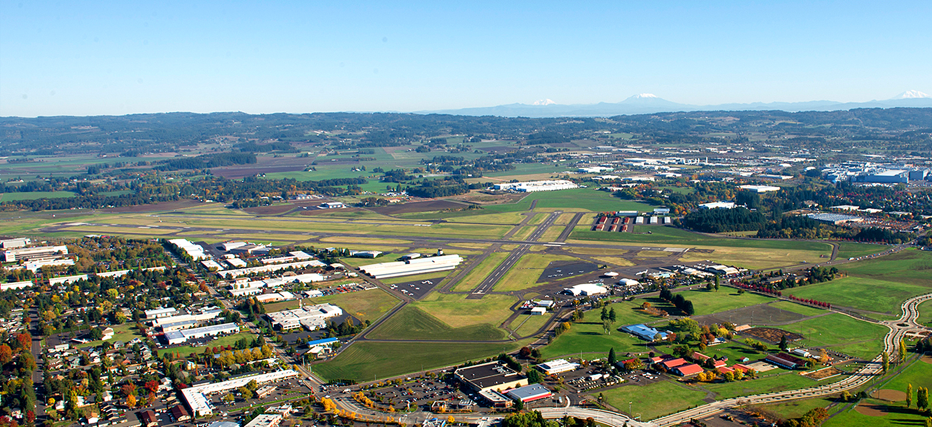
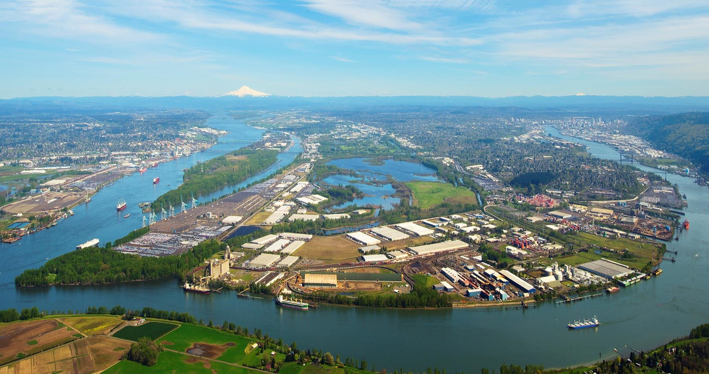
Our property footprint /
Nuestra Presencia Inmobiliaria
Troutdale Airport
Troutdale Reynolds Industrial Park
Aeropuerto de Troutdale
Parque Industrial Troutdale Reynolds
Gresham Vista Business Park
Portland International Airport
Parque Empresarial Gresham Vista
Hillsboro Airport
Terminal 2
Aeropuerto Internacional de Portland
Portland International Center
Terminal 2
Centro Internacional de Portland
Aeropuerto de Hillsboro
West Hayden Island
Swan Island
Isla West Hayden
Isla Swan
Terminal 6
Terminal 6
Rivergate Industrial District
Distrito Industrial Rivergate
Terminal 4
Terminal 4
Terminal 5
Terminal 5
Notes:
Nikoyia
SAY: This gives you an idea of our property footprint in the Portland Metro.
SAY: Using our resources, our expertise across industries, and our connections and influence, we:​
create thousands of jobs​
help local businesses of all sizes grow​
and help attract more quality employers to the state​
SAY: I’ll pass it to Steve to provide more details on Hillsboro Airport.

Slide 17
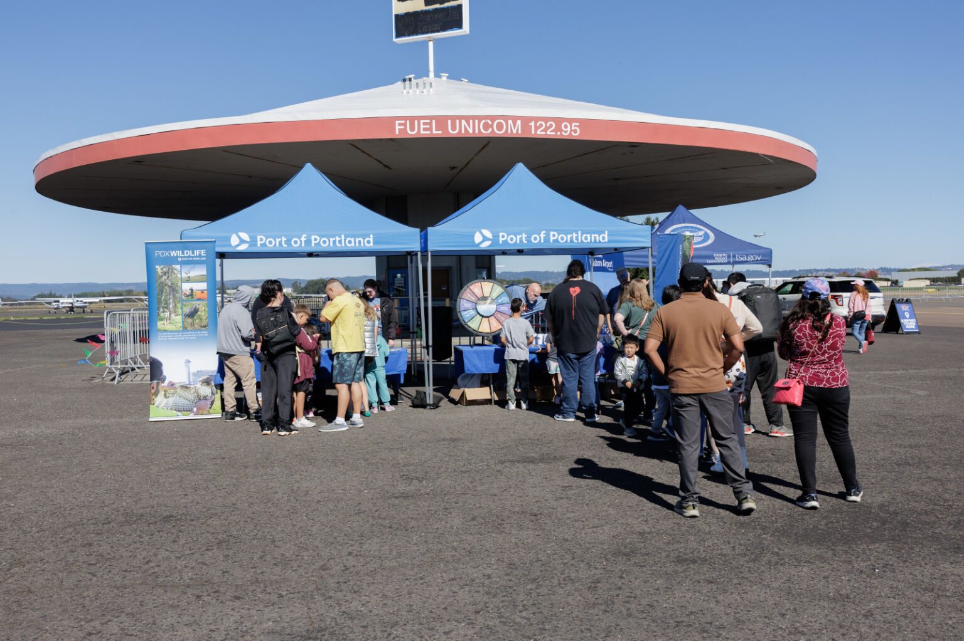
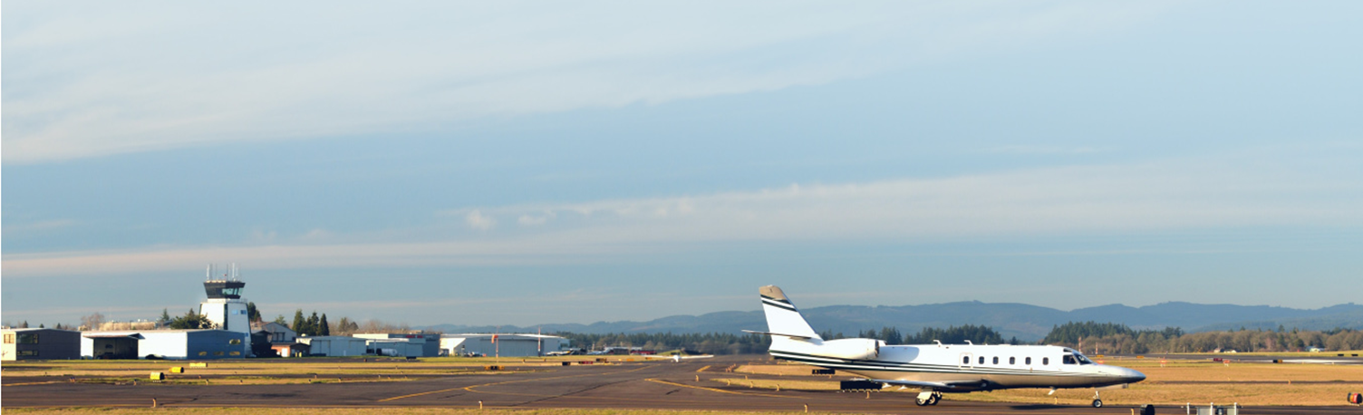
Hillsboro Airport / Aeropuerto de Hillsboro (HIO)
General aviation airport
2nd busiest airport in OR with 180k operations in 2023
Approximately 965 acres
350+ based aircraft; 40+ based business jets
Approximately 20 on-airport businesses
Aeropuerto de aviación general
Segundo aeropuerto más transitado de Oregón, con 180 000 operaciones en 2023
Aproximadamente 965 acres
Más de 350 aviones con base en el aeropuerto; más de 40 aviones ejecutivos con base en el aeropuerto
Aproximadamente 20 empresas en el aeropuerto
Notes:
Steve
SAY: My name is Steve Nagy, Director of Airport Operations.
SAY: Hillsboro Airport is a general aviation airport, which means it does not have scheduled
SAY: It is the second busiest airport in Oregon and spans about 965 acres.
SAY: In 2023, it had over 180,000 takeoffs and landings combined, which are also called operations.
SAY: We have over 350 based aircraft that are regularly stored at the airport, including more than 40 business jets
SAY: There are also about 20 on-airport businesses that I will talk about on our next slide.

Slide 18
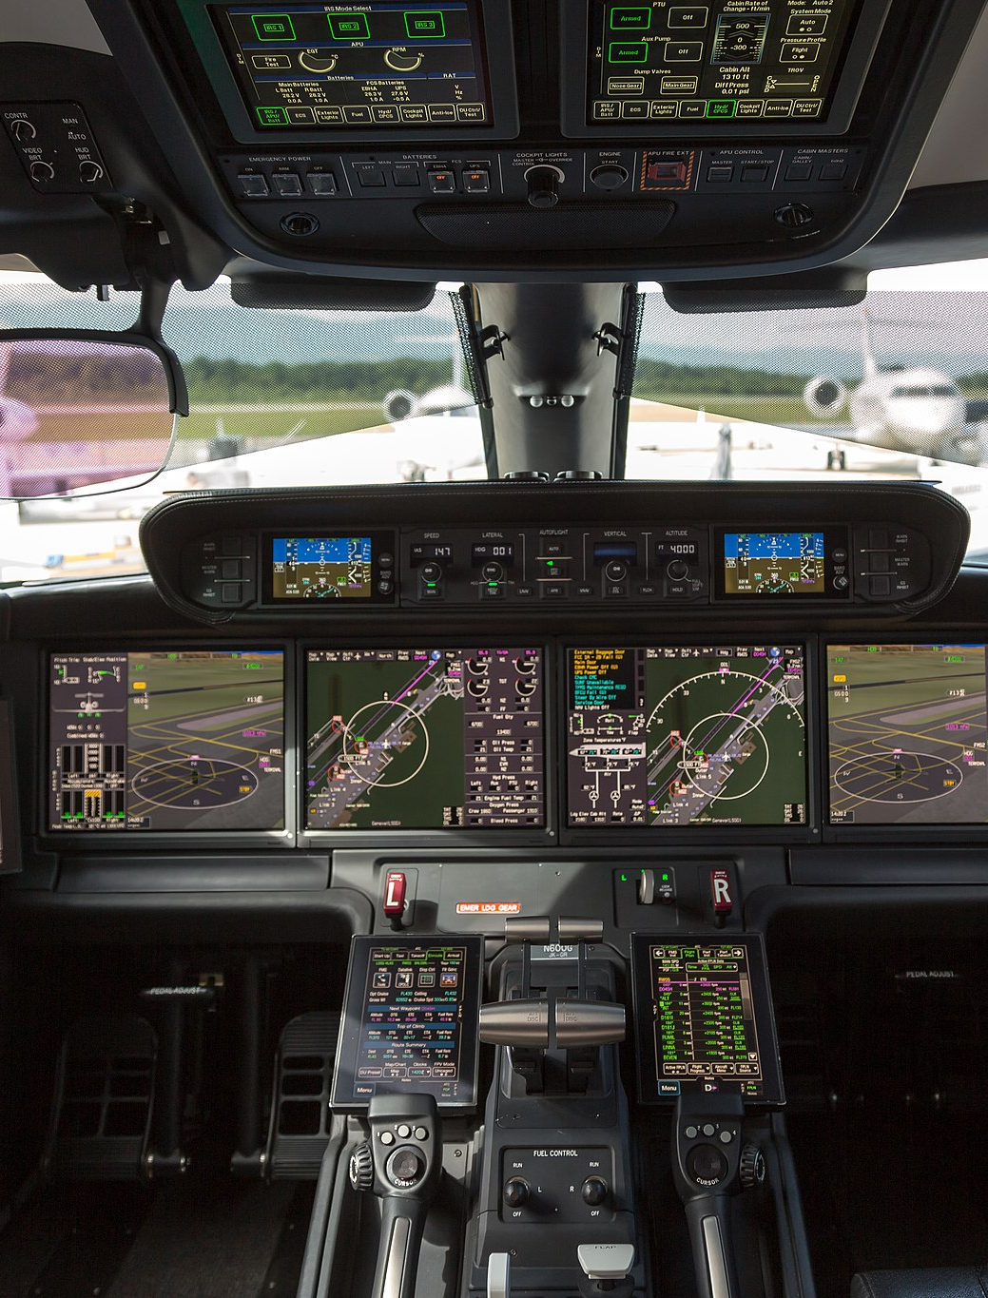
Hillsboro is unique among General Aviation airports / Hillsboro es único entre los aeropuertos de aviación general
Three Fixed Base Operators / Tres operadores de base fija
AERO AIR | GLOBAL AVIATION | HILLSBORO AVIATION
Local Corporate Flight Departments / Departamentos de vuelo corporativos locales
NIKE | COLUMBIA SPORTSWEAR | OCHOCO
Flight Training / Capacitación de vuelo
HILLSBORO AERO ACADEMY | NW WINGS AVIATION
Customs & Border Protection (coming soon) / Aduanas y Protección de Fronteras (próximamente)
Notes:
Steve
SAY: There are approximately 20 on-airport businesses including:
3 fixed base operators, which are companies that provide support services for aircraft and their crew such as fueling or space for parking.
Local corporate flight departments
Flight training schools; and
Customs and Border Protection coming soon

Slide 19
Business Report / Informe Comercial
Taxiway K Construction
New Air Traffic Control Tower Proposed
New Hangar Development
Taxiway and Ramp Maintenance and Reconstruction
2025 Oregon International Air Show
PDX 2045 Master Plan Update
Construcción de la pista de rodaje K
Propuesta de nueva torre de control del tráfico aéreo
Desarrollo de un nuevo hangar
Mantenimiento y reconstrucción de pistas de rodaje y rampas
Salón Aeronáutico Internacional de Oregón 2025
Actualización del Plan Maestro PDX 2045
Notes:
Steve
[Intro to covering the business report for Port of Portland focused on Hillsboro Airport]

Slide 20
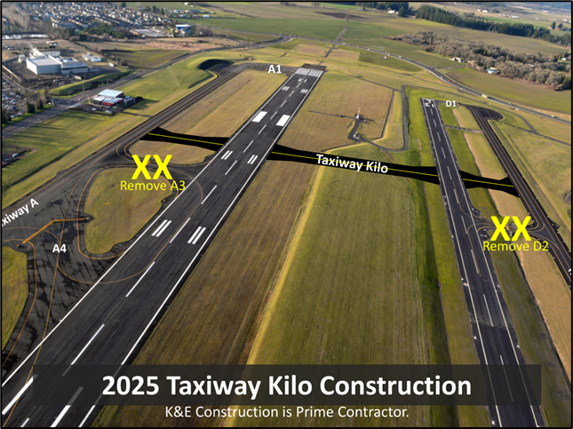
Taxiway K Construction / Construcción de la Pista de Rodaje K
Aerial rendering of new Taxiway Kilo and what taxiways will be removed
Representación aérea de la nueva pista de rodaje Kilo y de las pistas de rodaje que se eliminarán.
Notes:
Steve
Taxiway K Construction
Earlier this summer, the Port completed construction of a new crossfield taxiway at the north end of the airport (known as Taxiway K) . The taxiway was constructed to improve circulation options for aircraft as they taxi on their way to taking off or after landing. The new taxiway also replaces two exiting exits on the primary and training runways.
The new Taxiway K allows aircraft to more efficiently get from the west to east sides of the airport with less distance to taxi. This saves time for pilots and a reduces fuel usage by aircraft.

Slide 21
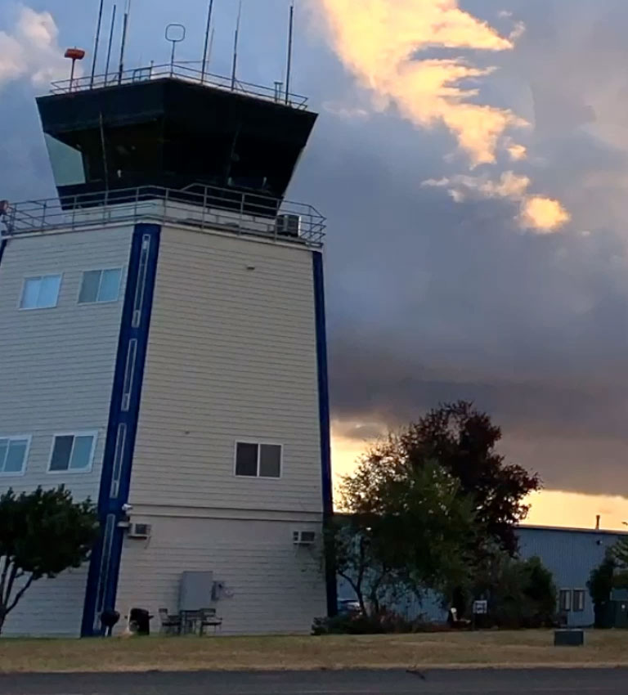
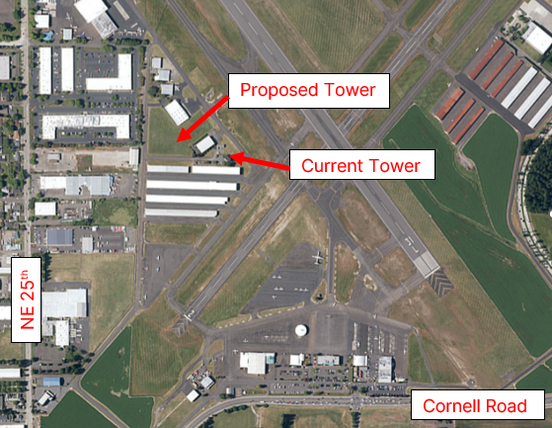
Air Traffic Control Tower Proposed / Propuesta de Torre de Control de Tráfico Aéreo
Existing Air Traffic Control Tower (left) and proposed new Air Traffic Control Tower location (right)
Torre de control de tráfico aéreo existente (izquierda) y ubicación propuesta para la nueva torre de control de tráfico aéreo (derecha)
Notes:
Steve
New Air Traffic Control Tower (ATCT) Proposed at HIO
At HIO, ATCT is located on the western side of the airport and was completed about 60 years ago. This FAA-staffed facility is outdated with insufficient office space and no longer meets the needs of aviation activity at HIO. In addition, it is difficult to add new modern air traffic management equipment in the existing tower.
To address these issues, the FAA has proposed building a new tower west of the existing tower, a project that will be funded by the FAA. The parcel proposed for development is currently vacant. In addition to being a modern facility, the new tower will allow air traffic controllers an improved view of the entire airfield.
Currently, the FAA is conducting environmental and stormwater studies of the proposed location and is finalizing design and site plans. Once these are in place, the FAA will move forward with construction. The Port is providing the FAA with needed documentation and other support during the design phase of the project.
The FAA does not have a specific timeline for the start of construction or the completion of the new tower, but until a new tower is complete, tested and commissioned, the existing tower will continue to serve HIO.

Slide 22
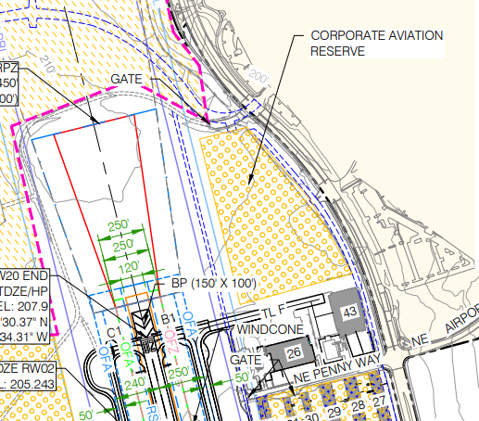
New Hangar Development / Nuevo Desarrollo de Hangares
Image showing the Sky Harbour parcel and the designation of Corporate Aviation Reserve on the Airport Layout Plan
Imagen que muestra la parcela de Sky Harbour y la designación de Reserva para Aviación Corporativa en el plano del aeropuerto.
Notes:
Steve
New Hangar Development at HIO
Sky Harbour is a private company that operates facilities to support business aircraft owners at several airports around the United States. They have entered into land lease negotiations with the Port of Portland for a currently-undeveloped parcel on airport property adjacent to Brookwood Parkway. This area of the airport was designated for future business aviation development in the 2018 Hillsboro Airport Master Plan.
The company is working with the City of Hillsboro on obtaining development permits and had a public meeting about the project on October 29 . The new development will access NE Brookwood Parkway at the intersection of Brookwood and the entrance to the Hillsboro Public Library. This intersection already has a traffic signal. On the airfield, this development will access the existing taxiway system.

Slide 23
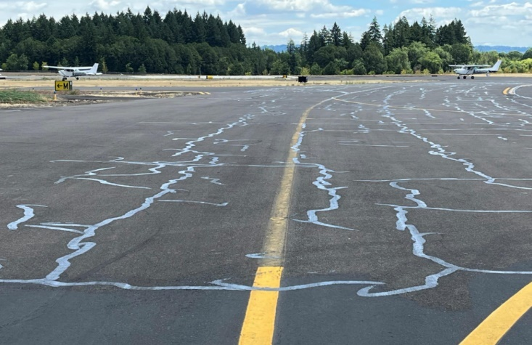
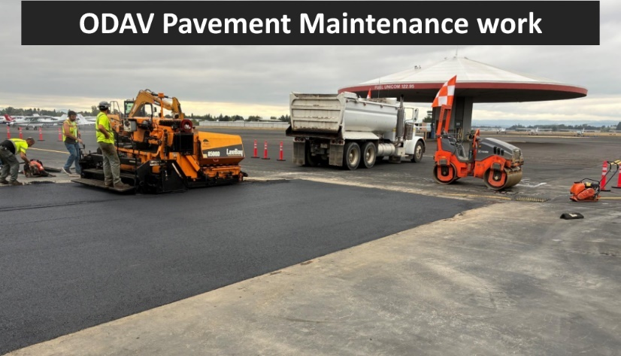
Taxiway and Ramp Maintenance and Reconstruction / Mantenimiento y Reconstrucción de Pistas de Rodaje y Rampas
Trabajos de Mantenimiento de Pavimentos de ODAV
Finished taxiway crack seal project (left) and ODAV-funded sealcoat project (right).
Proyecto terminado de sellado de grietas en la pista de rodaje (izquierda) y proyecto de recubrimiento sellador financiado por la ODAV (derecha).
Notes:
Steve
Taxiway and Ramp Maintenance and Reconstruction
Pavement management and maintenance is critical for the safe and efficient operation of an airport as busy as HIO. As an airport sponsor, the Port of Portland takes pavement management seriously. Earlier this summer multiple maintenance and repair projects were completed to extend the life of existing pavement or replace pavement that had reached the end of its useful life. The Port maintains a maintenance plan for taxiways, runways, ramps and vehicle service roads.
To prevent cracks from spreading, Port staff sealed cracks in many locations around HIO. The Port also engaged an outside contractor to sealcoat portions of the ramp near the terminal building and former aircraft fueling facility known as the “mushroom”.
The Port uses a variety of funds to pay for these projects including Oregon Department of Aviation (ODAV) funds, federal funds and contributions from the Port. These projects ensure that pavement remains useful and in good condition for as long as.
At a certain point, pavement wears out to the point it needs to be replaced entirely. This was the case with Taxiway B which runs parallel to the crosswind Runway 2-20. During summer 2025 much of Taxiway B was rebuilt and repaved. Reconstructing this taxiway ensures this remains a useable and functional part of the taxiway system for decades to come.

Slide 24


Oregon Air Show / Exhibición Aérea de Oregón
Photos of 2025 Oregon International Air Show performances. (Kyle Lopez Photography)
Fotos de las actuaciones de la Exhibición Aeronáutica Internacional de Oregón 2025. (Fotografía de Kyle López)
Notes:
Steve
2025 Oregon International Air Show
The 2025 Oregon International Air Show at HIO happened in May of the year. Approximately 48,500 people visited during the event and the air show was supported by over 1000 volunteers. There were civilian and military performances and ommunity exhibits, including exhibits promoting science, technology, engineering and math (STEM) education and carreer paths. 2000 third graders and 800 eighth graders from many area schools had the opportunity to attend the event and tour the STEM exhibits. Next year’s show is planned for May 15-15 2026.

Slide 25
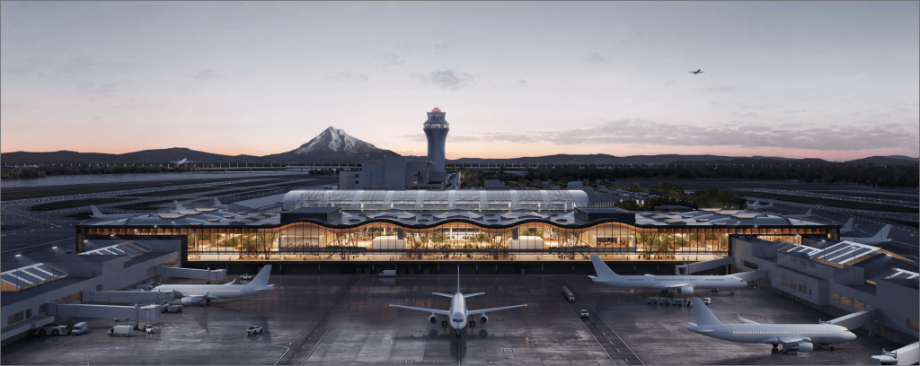
PDX 2045 Master Plan Update / Actualización del Plan Maestro PDX 2045
Rendering of the expanded main terminal at PDX which was identified in Airport Futures and opened in 2024.
Representación de la ampliación de la terminal principal del aeropuerto PDX, identificada en Airport Futures e inaugurada en 2024.
Notes:
Steve
PDX 2045 Master Plan Update
Airports occasionally update their master plans to ensure that forecast future growth can be accomodated. HIO’s current master plan was finalized in 2018 and the Port engaged with the community as that plan was developed.
The Port is currently in the midst of this process at PDX as the PDX 2045 Master Plan enters the final phases of development. We rely on public input and community participation to help ensure our plans meet community needs. Visit pdx2045.org to learn more about the plan, find opportunities to attend public meetings and events, and provide your input about the future of PDX.

Slide 26
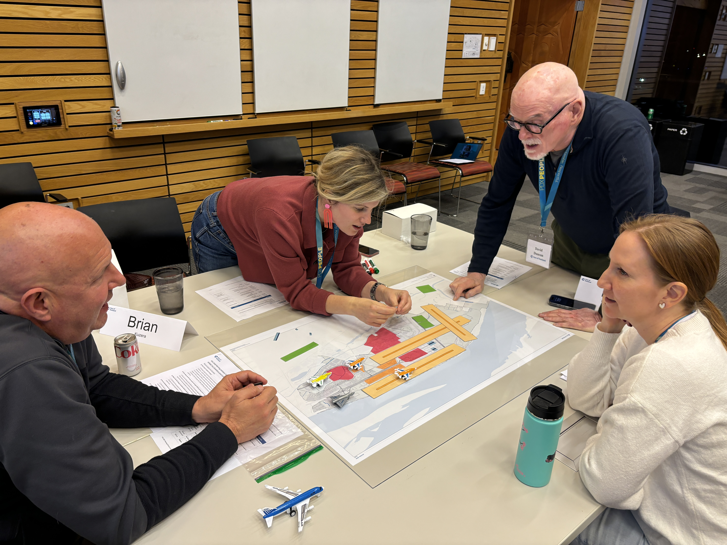


Public Comment
Your feedback is essential!
Please take our survey by scanning the QR code below or fill out a paper survey.
See the latest news and sign up for project updates on pdx2045.org​
Notes:
Bridger can relink the QR code so we don’t need to re-print or update here (CHECK)

Slide 27
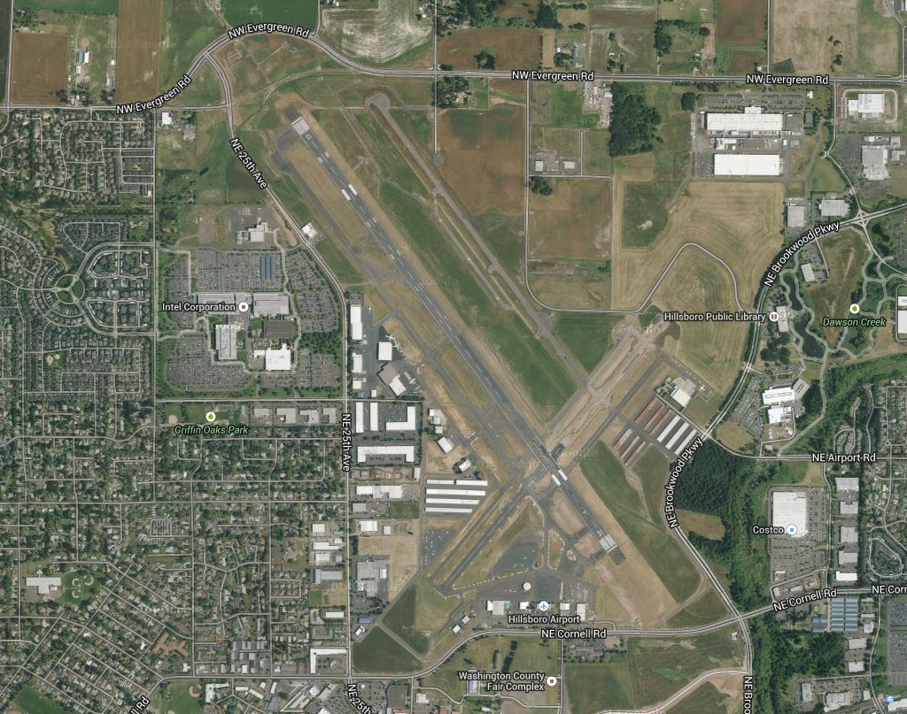
Aircraft Noise Program / Ruido de los Aviones
Public noise reporting via noise hotline, online web form and email
  www.portofportland.com/NoiseManagement
Strive to identify opportunities to reduce noise impacts where feasible
“Fly Friendly” program
  Encourages pilots to follow voluntary noise abatement procedures
Administración del ruido
  Denuncia pública del ruido a través de la línea directa, el formulario web y el correo electrónico
  www.portofportland.com/Noise
  Management
  Esfuerzo por identificar oportunidades para reducir el impacto del ruido siempre que sea posible
Programa “Fly Friendly”
  Se anima a los pilotos a seguir procedimientos voluntarios de reducción del ruido
Notes:
Steve (Pass to Nikoyia after this slide)
Aircraft noise is an area of concern at Hillsboro Airport where we have noise-sensitive areas to the west, south, and east.
FAA establishes thresholds for aircraft noise and has authority over aircraft in flight.
Public noise reporting is an important part of the noise program and allows for community feedback via the Port's noise hotline, online webform and email
We strive to identify opportunities to reduce noise impacts where feasible such as:
In 2015, a new runway separated flight training activity to the east side of the airfield away from residential areas.
In 2019, almost all helicopter flight training activity was moved from Hillsboro to Troutdale where training patterns don't extend over residential areas.
Additionally, to address community concerns about noise, the Port partnered with the FAA’s Air Traffic Control Tower and the flight schools to implement a “fly friendly” program. This voluntary program encourages pilots to follow procedures that are intended to reduce the impact of aircraft noise for the community. These procedures include:
Avoid overflying the same location repeatedly during training
Manage prop pitch and power setting to minimize noise
Utilize flight paths that overfly sparsely populated areas
When possible, fly around noise sensitive areas
Instructors are encouraged to point out noise sensitive areas to their students
The Port is committed to continue to address challenges related to aircraft noise that affects our community members and work in good faith towards solutions.

Slide 28
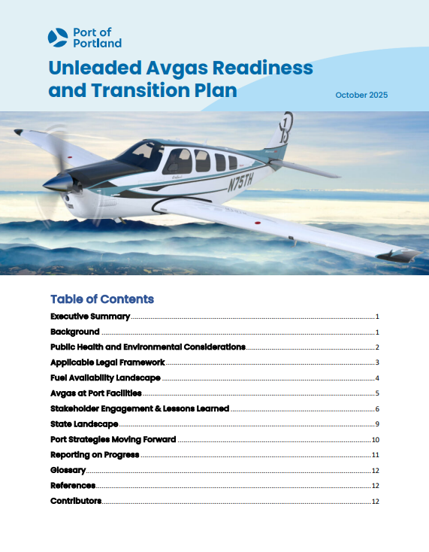
Bringing Unleaded Aviation Fuel to Hillsboro Airport / Introducción del Combustible de Aviación sin Plomo en el Aeropuerto de Hillsboro
Initial outreach included pilots, roundtable participants, elected officials, and local leaders
Draft readiness and transition plan released for feedback August 12-26
Feedback used to ensure the plan is clear and easy to understand
Final plan and updates: portofportland.com/hio/leadfreefuel
La promoción inicial incluyó a pilotos, participantes en mesas redondas, funcionarios electos y líderes locales.
Se publicó un borrador del plan de preparación y transición para recibir opiniones entre el 12 y el 26 de agosto.
Se utilizaron las opiniones para garantizar que el plan fuera claro y sencillo de entender.
Plan definitivo y actualizaciones: portofportland.com/hio/leadfreefuel
Notes:
Nikoyia
SAY: The Port of Portland is committed to bringing unleaded aviation fuel to Hillsboro Airport. We see this transition as an opportunity to reduce emissions, improve air quality, and align with national efforts to eliminate lead from aviation gasoline.
SAY: We recognize this is an important issue for Hillsboro residents. We also know we cannot make all regulatory and supply chain changes ourselves. What we can do is prepare our facilities and support voluntary adoption.
SAY: This is why in August, we released our Unleaded Avgas Readiness and Transition Plan. We invited public feedback on the draft, focusing on making sure our plan was clear and useful.
SAY: We invited folks to provide feedback who had participated in previous engagements like roundtables and a pilot focus group as well as elected officials and local government leaders.
SAY: Based on this feedback, we clarified key sections in the plan and adding a timeframe for engagement with the Hillsboro flight school.
SAY: Some feedback didn’t lead to plan edits but were important for us to note. For example, requests for more historical avgas data, or for the Port to analyze health impacts directly. We clarified that while we report on fuel volumes to show why HIO is a priority, public health agencies remain the most appropriate sources for health data. Other feedback is captured and available on our website: https://portofportland.com/hio/leadfreefuel
SAY: Overall, the input we received sharpened our plan so that it better reflects what we can do now and how we’ll continue to share information as the transition progresses.
SAY: The final plan and progress updates are available at portofportland dot com forward slash "hio" forward slash "leadfreefuel“
SAY: I’ll now pass it to my colleague, Nikoyia Phillips, to share a recap of the Block Party at the Airport

Slide 29

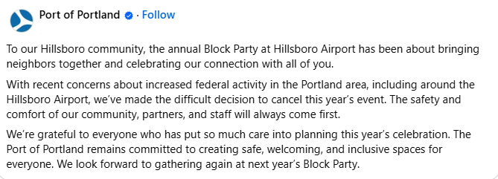

Actualización del Evento:
Para nuestra comunidad de Hillsboro, la celebración anual del Evento Comunitario (Block Party) en el aeropuerto de Hillsboro ha sido una ocasión para reunir a los vecinos y celebrar nuestra conexión con todos ustedes.
Debido a la reciente preocupación por el aumento de la actividad federal en el área de Portland, incluyendo los alrededores del aeropuerto de Hillsboro, hemos hecho la difícil decisión de cancelar el evento de este año. La seguridad y la comodidad de nuestra comunidad, nuestros asociados y nuestro personal siempre serán lo primero.
Agradecemos a todas las que han puesto tanto cuidado en la planificación de la celebración de este año. El Puerto de Portland mantiene su compromiso de crear espacios seguros, acogedores e inclusivos para todas. Esperamos volver a reunirnos en el Evento Comunitario (Block Party) del próximo año.
El Evento Comunitario del Aeropuerto de Hillsboro ha Sido Cancelado
Notes:
Nikoyia
SAY: As many folks know, we made the difficult decision to cancel this year’s Block Party. We made this decision because of recent concerns about increased federal activity in the Portland area, including around the Hillsboro Airport.
SAY: The safety and comfort of our community, partners, and staff will always come first. I want take a moment to thank everyone who put so much care into planning this year’s celebration.
SAY: While a lot of folks were disappointed, we also heard a lot of understanding and support for the decision.
SAY: And while this year didn’t go as planned, we’re already looking forward to being back together for next year’s Block Party — always the second Saturday in October.
SAY: With that, I’ll pass it back to Frances to lead our Q&A or public comment section.

Slide 30

Q&A / Preguntas y Respuestas
For Zoom participants, to provide comment or ask a question:
Add your full name to the Q&A box
Each speaker has 3 minutes
In-person participants, write your name on the sign-up sheet.
Para los participantes por Zoom, para hacer un comentario o una pregunta:
Agregue su nombre completo en el cuadro de Preguntas y Respuestas (Q&A).
Cada orador tiene 3 minutos.
Participantes en persona,
escriba su nombre en la hoja de inscripción.
Notes:
FRANCES

Slide 31
Thank you! / ¡Gracias!
Please take our survey
/ Por favor, responde nuestra encuesta
https://bit.ly/HIOshare

Slide 32
HIO Fall Forum Dress Rehearsal

Slide 33
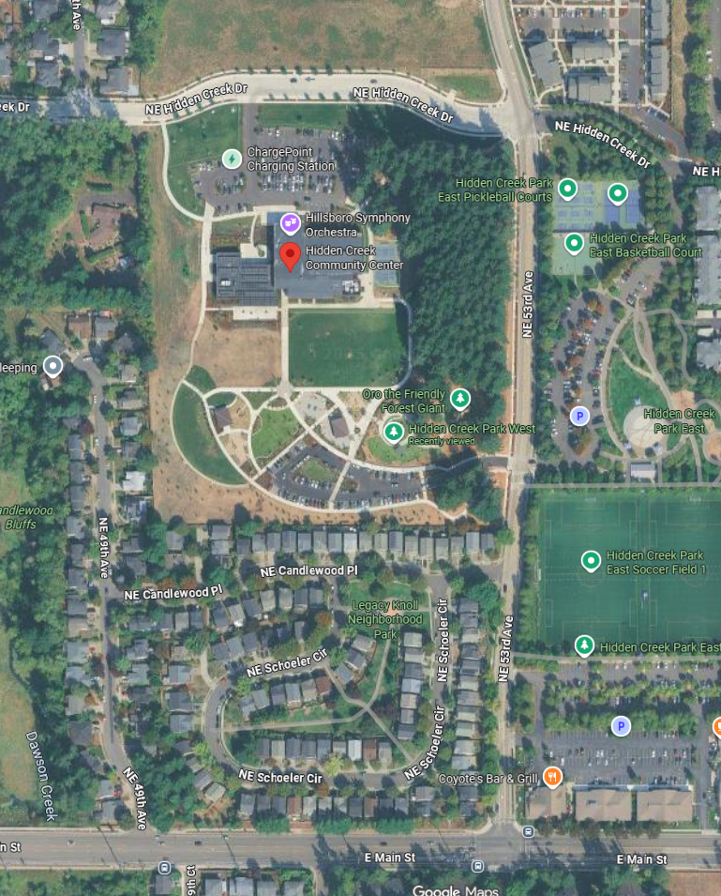
Hidden Creek Community Center
Time
Arrive by 4:30pm
Start presentation at 5:10pm
End presentation 6:30pm (6-6:30pm public comment)
Getting there
Bus 47, Main St. and 53rd Ave by Coyote’s, 0.3-mile walk
Parking in front (135 spots) with overflow parking at Hidden Creek Park West
Inside the center
Tualatin River Room (40-person capacity)
Five Oaks Room (20-person, supervised children’s activities)
Safety
Considered private event space
Spanish interpreters
1 virtual, 1 in-person

Slide 34
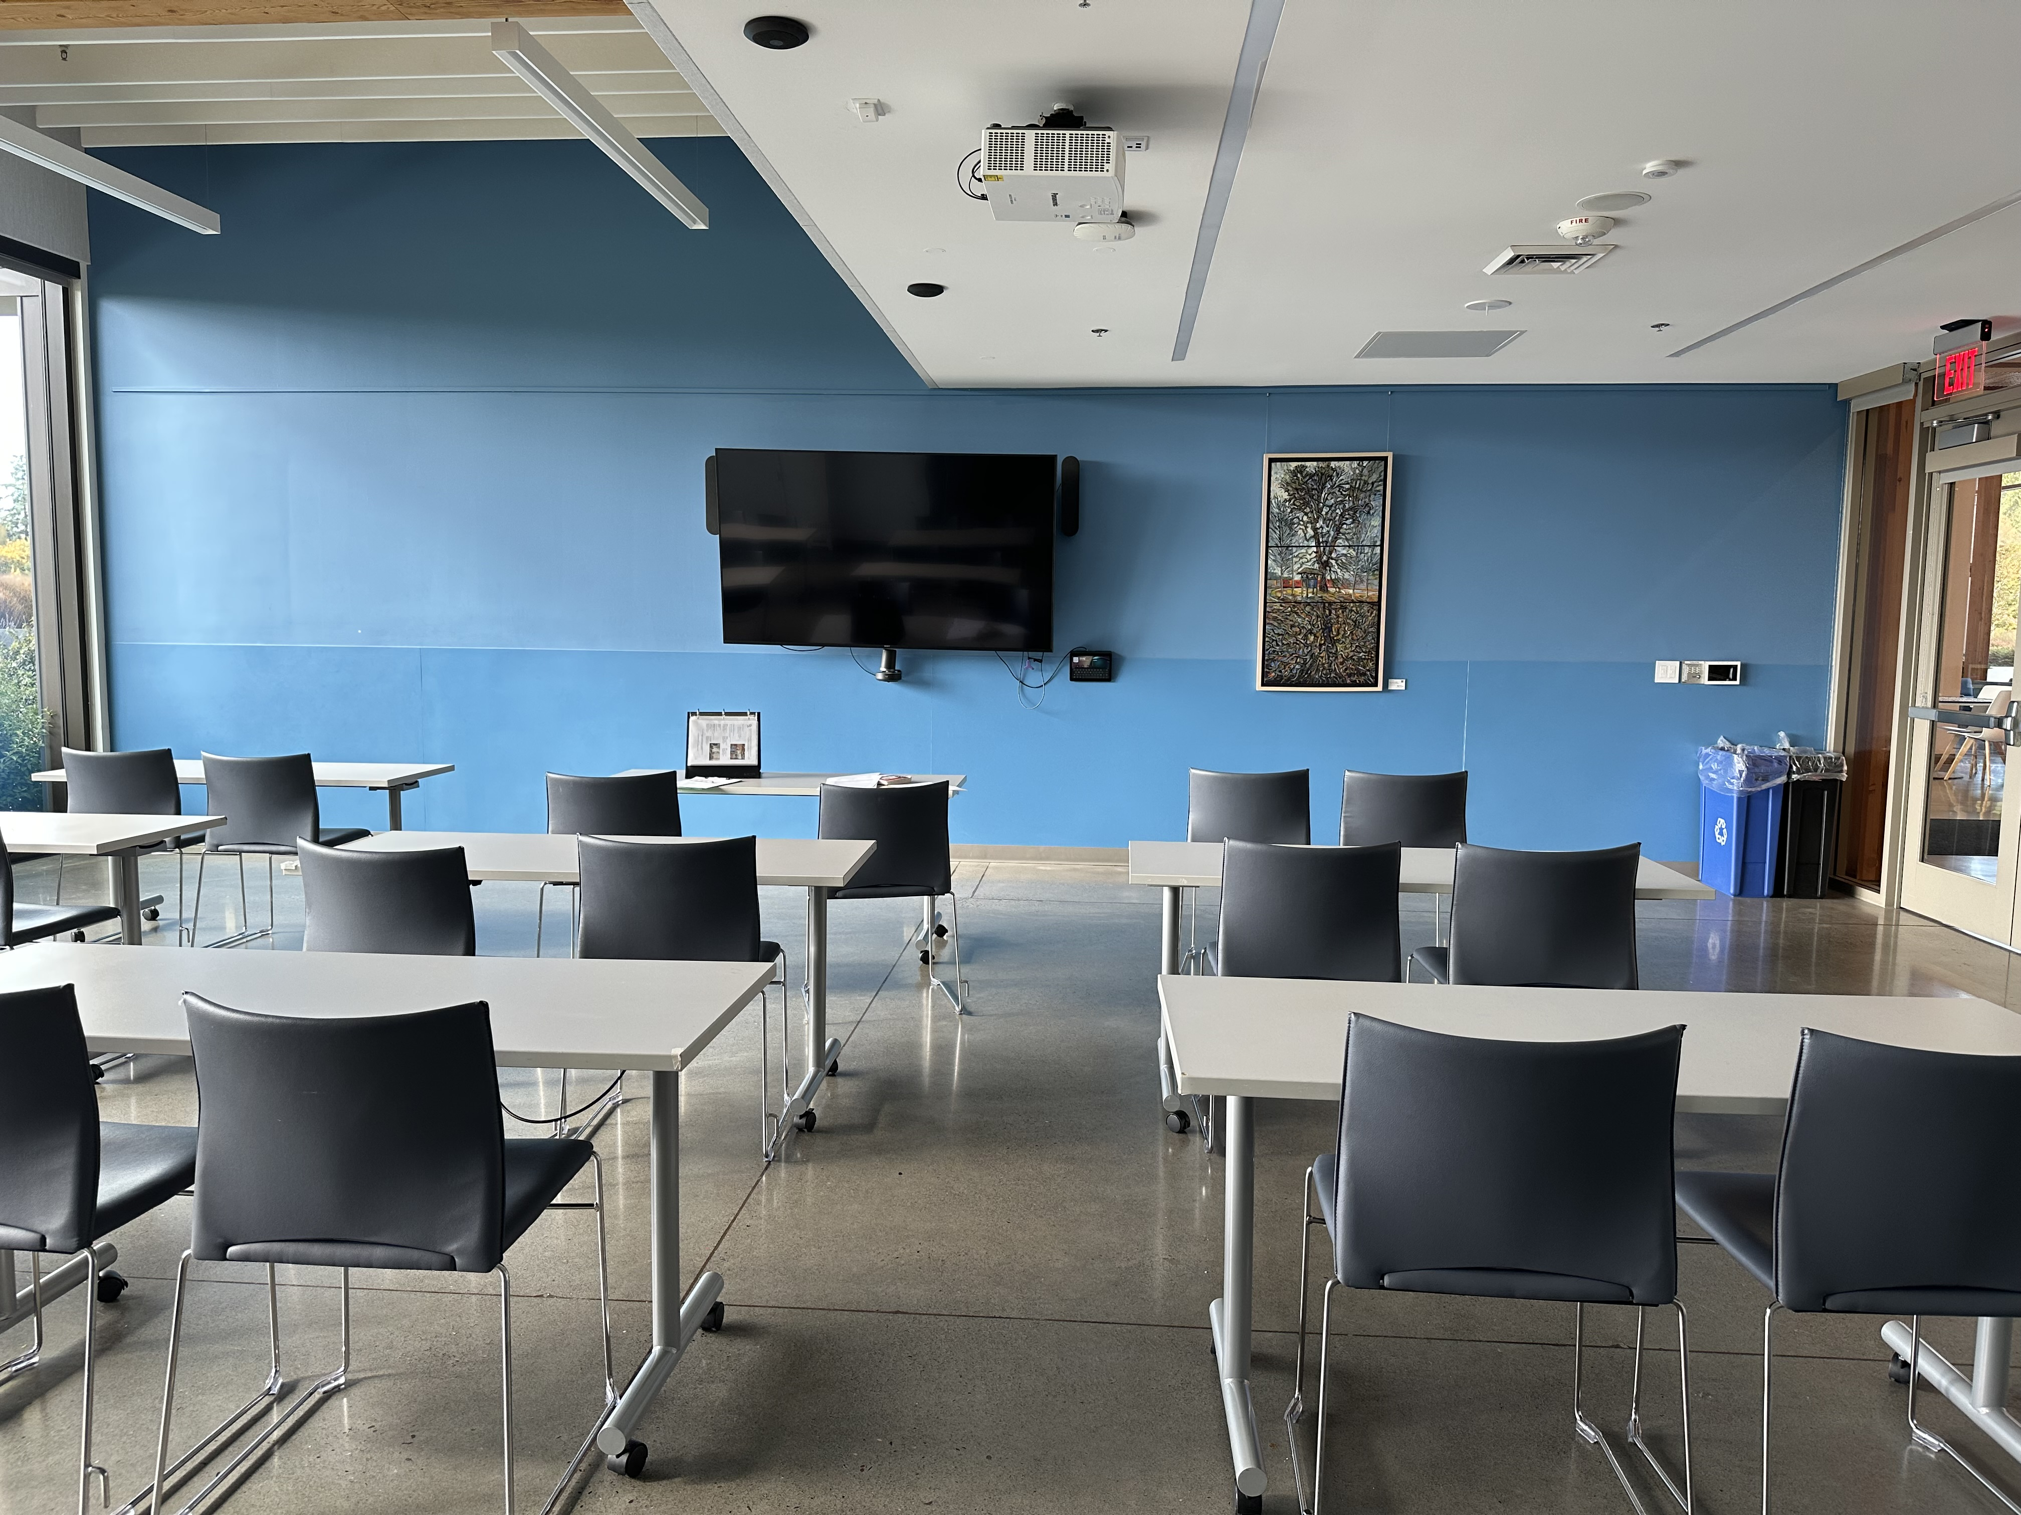
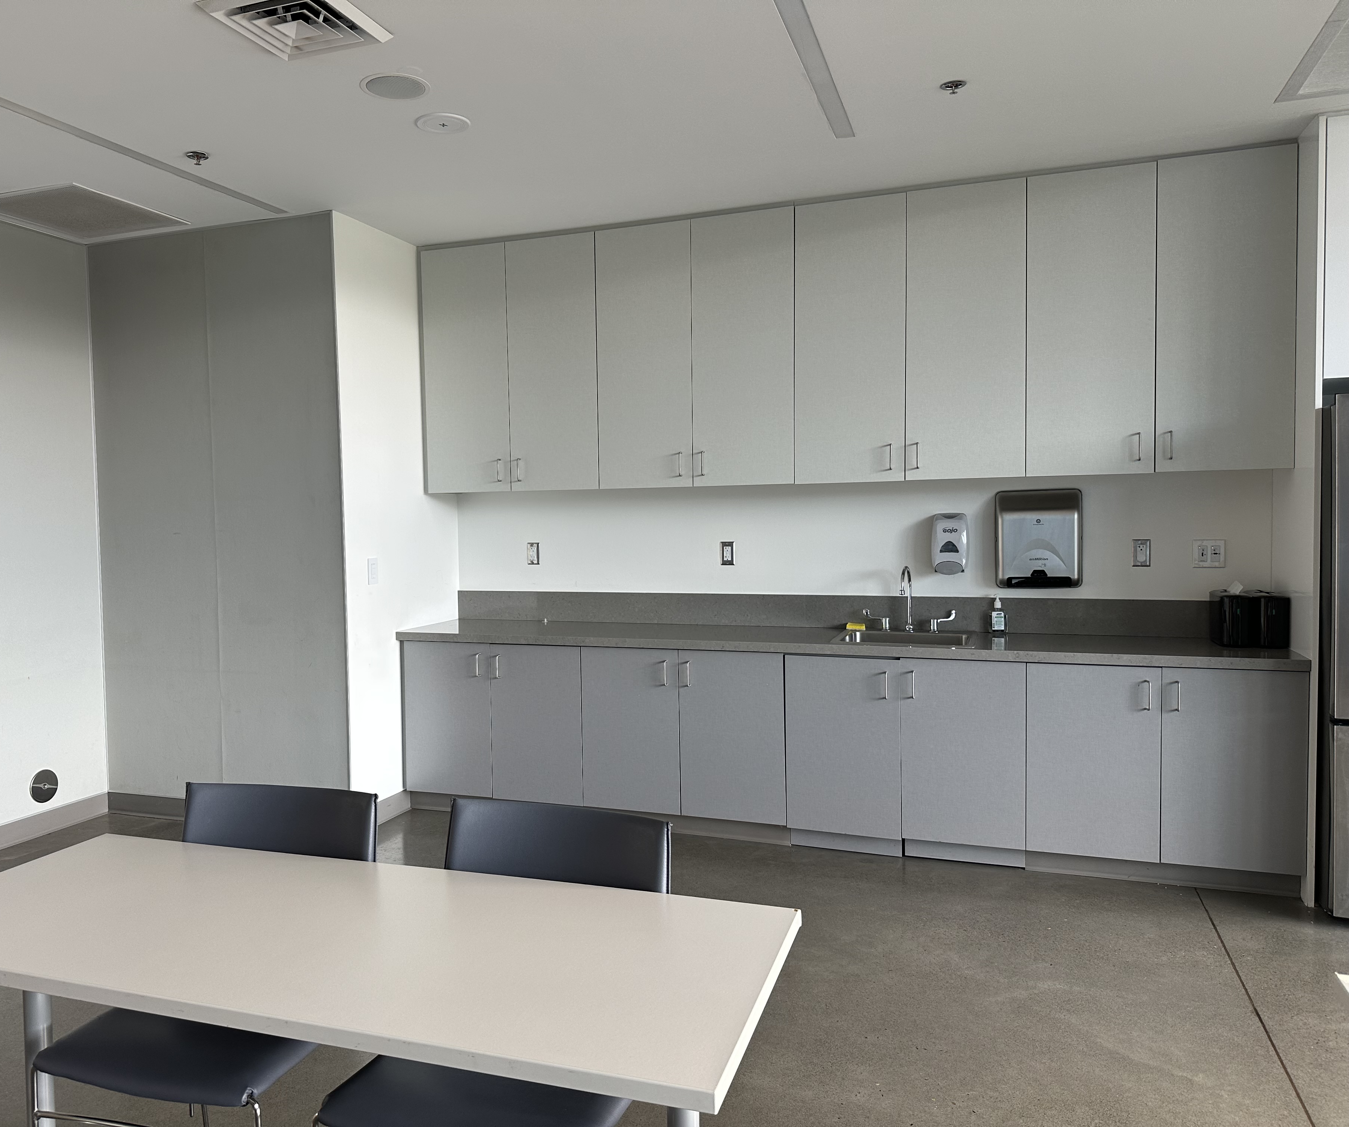
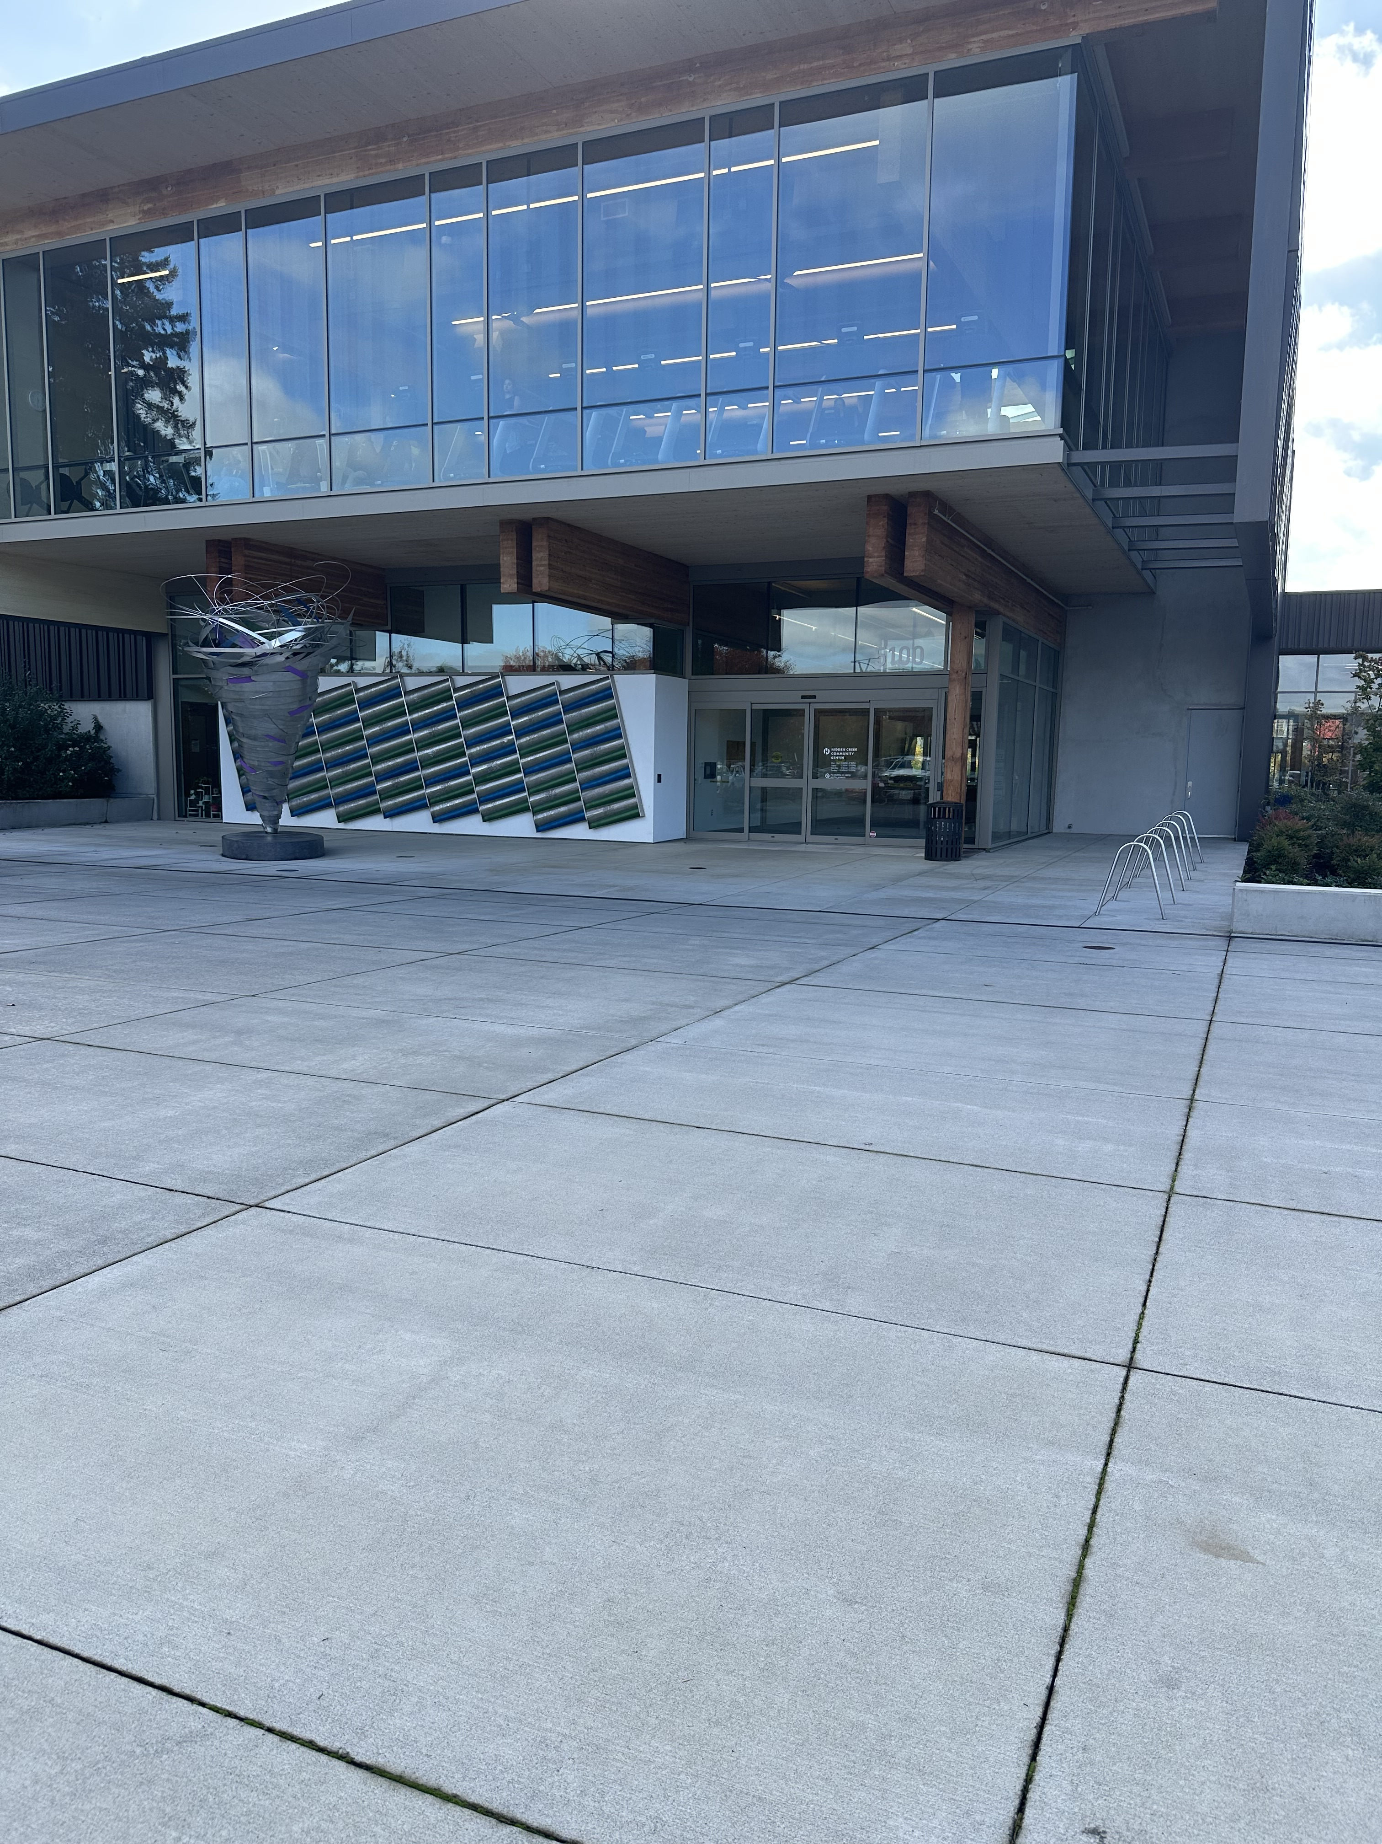
Hidden Creek Community Center
Entrance, will bring 1 a-frame board
Tualatin River Room from back
Zoom capability
Tualatin River Room kitchenette

Slide 35
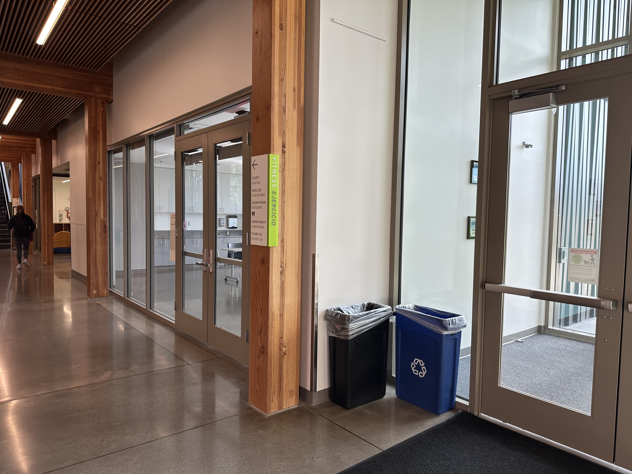
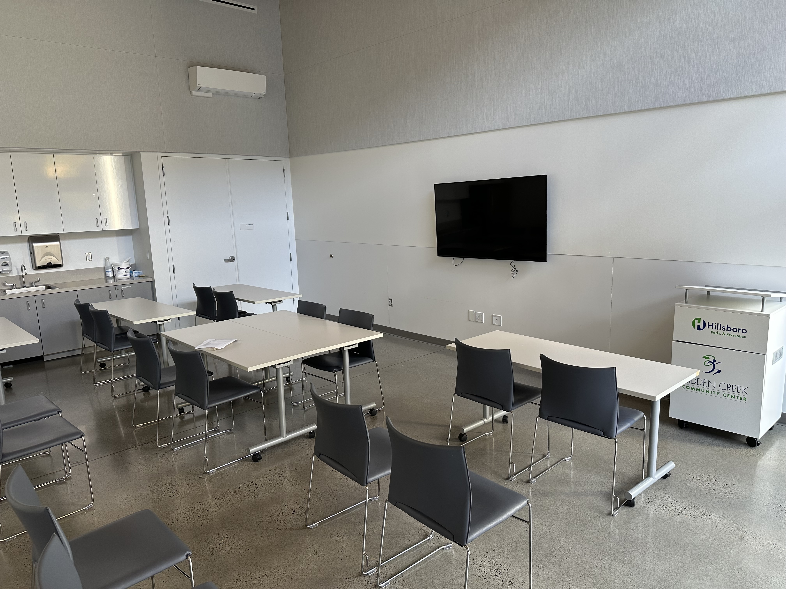
Hidden Creek Community Center
Entrance into Tualatin River Room, reception desk to left;
Check-in table location
Five Oaks Room (down the hall)
Note: temp is colder

Slide 36

Fall Forum Outreach Update
Attendees:
24 in-person
3 virtual
10 staff and interpreter
Outreach:
Community sponsors (Greater Than, OASCF)
Port channels (social media, newsletter)
Emails to stakeholder lists (HACA, public commenters)
WashCo Community Participation Organizations, City of Hillsboro, WashCo Chamber of Commerce, Downtown Hillsboro Partnership; Hillsboro Libraries

